Slide 1
The Future of Free Expression Online
Nick Feamster Princeton University

Slide 2
Control of Online Speech
Who gets to speak? Filtering and manipulation of Internet protocols
HTTP, TCP/IP, DNS
Circumvention tools (e.g., Tor)

Slide 3
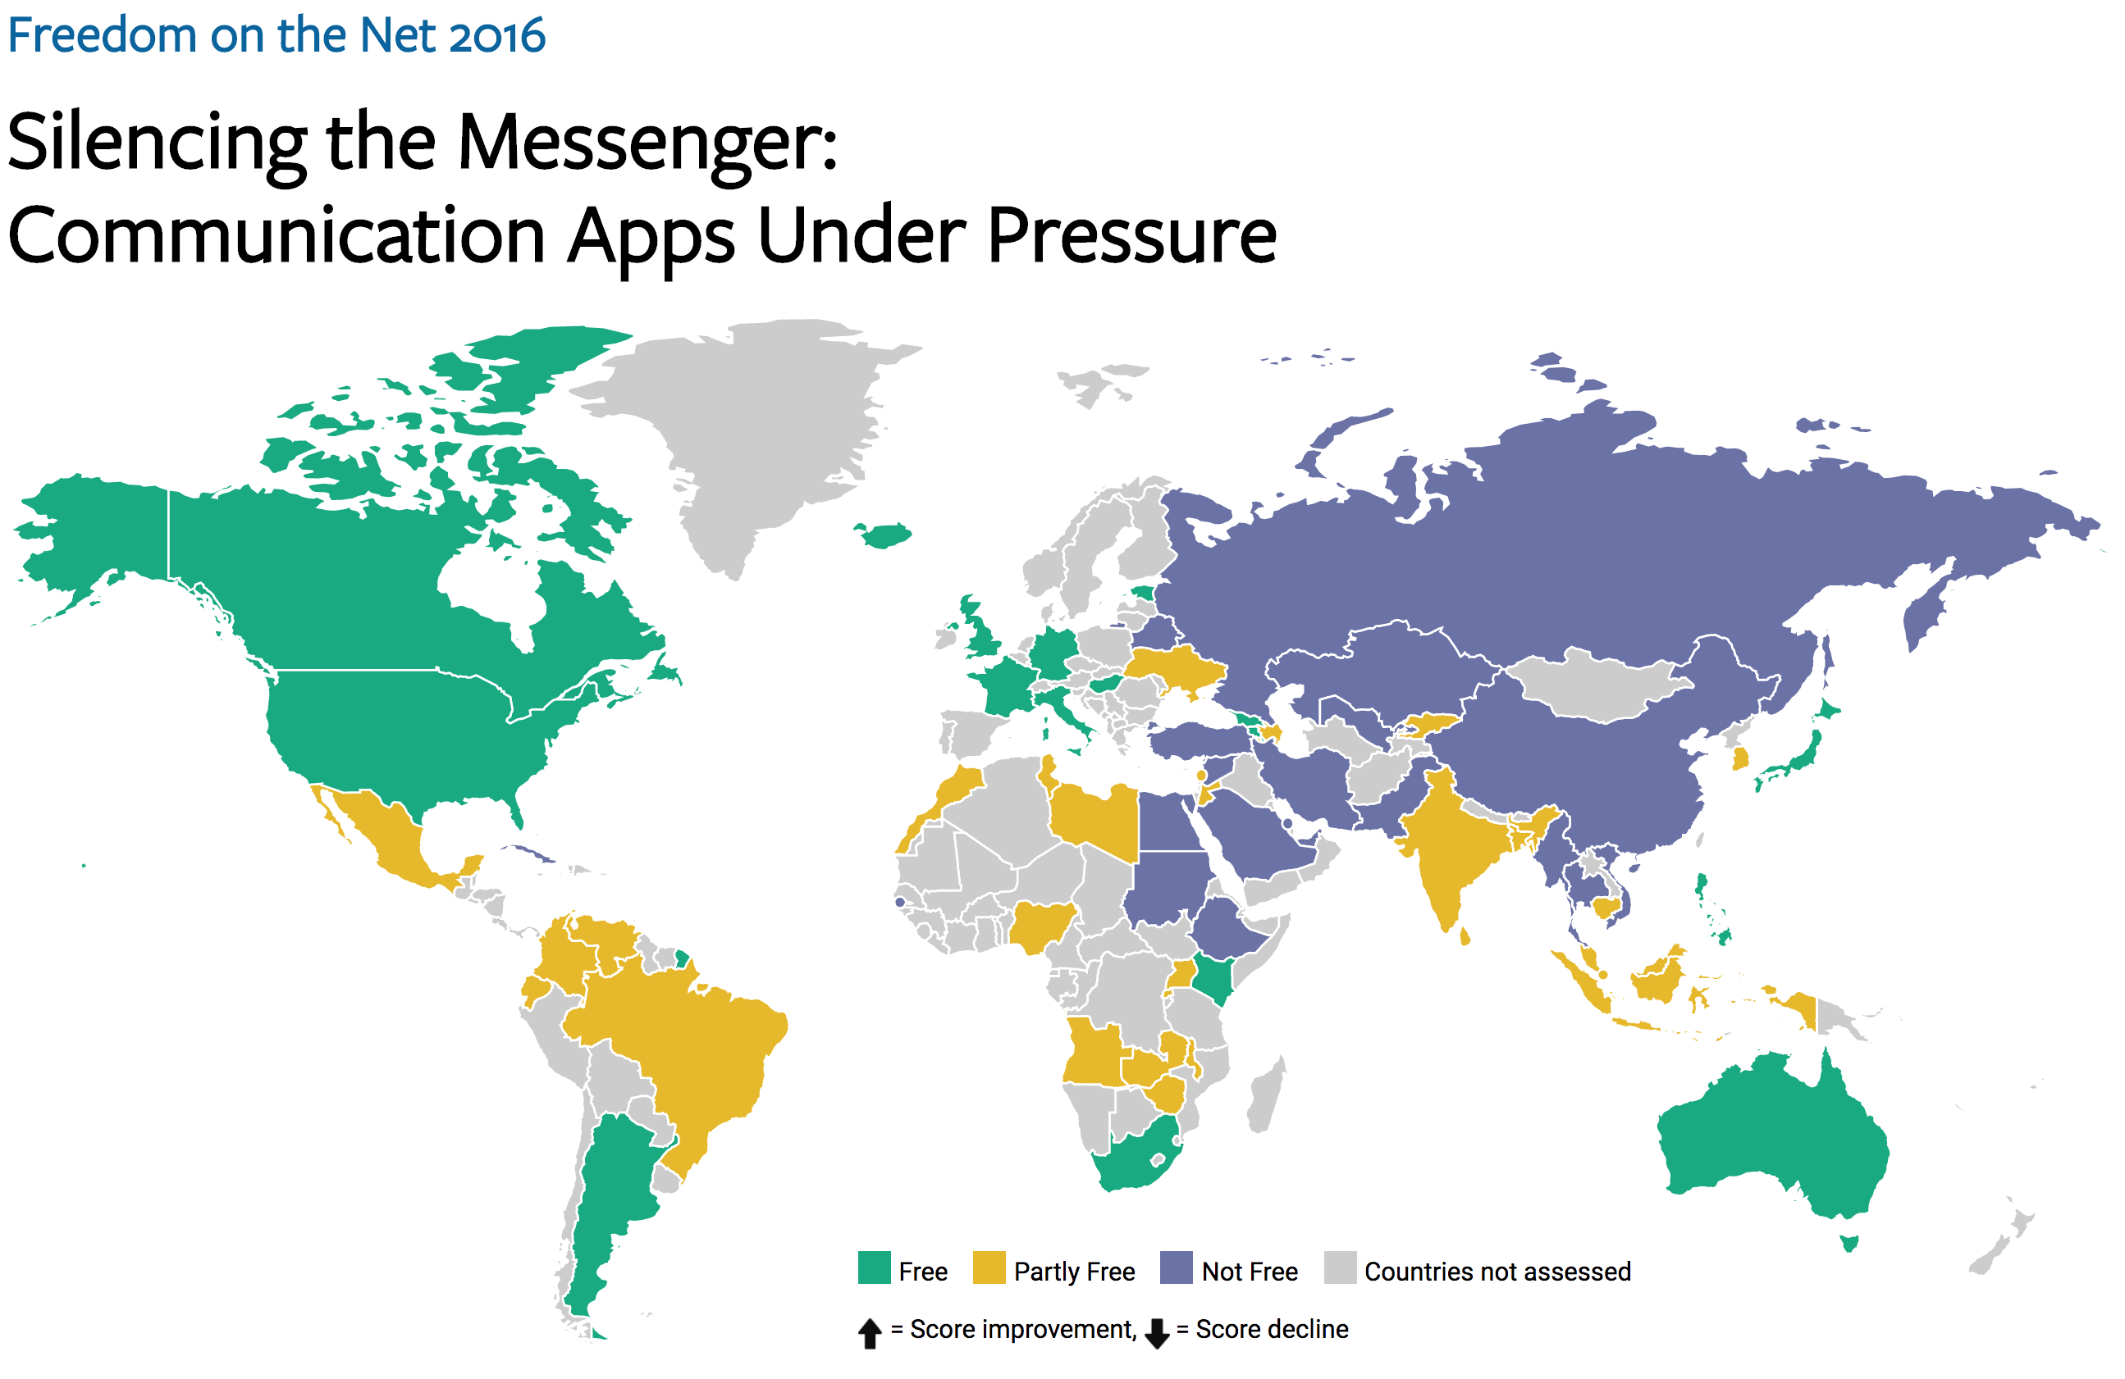

Slide 4





Censorship Measurement Today
Anecdote
(Twitter censored in Iran)
Researcher
Custom measurement software
Vantage points
Censor
Web service
Notes:
The biggest drawback is scale
Still effectively anecdotes
Political and social scientists want more data
The Citizen Lab, Berkman Center, Princeton, etc.

Slide 5
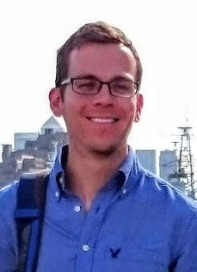
Encore: Measure Using Web Browsers
Anecdote
(Twitter censored in Iran)
Custom software
Researcher
Every Web browser is a potential vantage point
Instrumented
Web page
<iframe
src="//encoreenco.re/task.html"
width="0" height="0"
style="display: none">
</iframe>
Volunteer Web site
Vantage points
Censor
Web service

Slide 6
How Encore Works
Origin Web site
GET /
Vantage point
“Can you access http://twitter.com?”
http://encoreenco.re
Web browser
in Iran
Cross-origin
GET /favicon.ico
Measurement target
How?
Censor
http://twitter.com
Burnett, Sam, and Nick Feamster. "Encore: Lightweight measurement of web censorship with cross-origin requests." ACM SIGCOMM. 2015

Slide 7
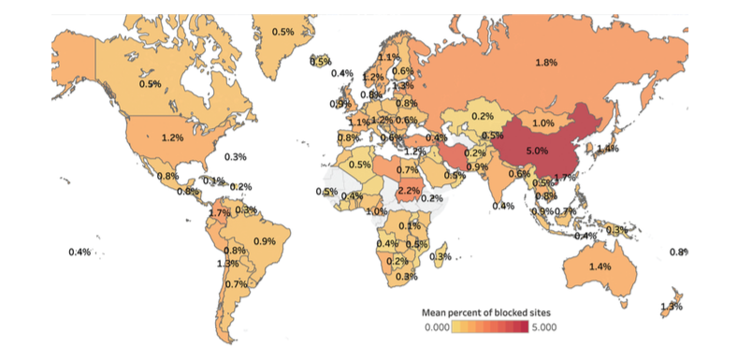
Pearce, Paul, et al. "Augur: Internet-Wide Detection of Connectivity Disruptions." Security and Privacy (SP), 2017 IEEE Symposium on. IEEE, 2017.
Notes:
Global heat map showing the percentage of sites filtered for any client in countries around the world. China experiences the highest average amount of filtering, at 5% of measurable sites filtered by a resolver within the country.

Slide 8
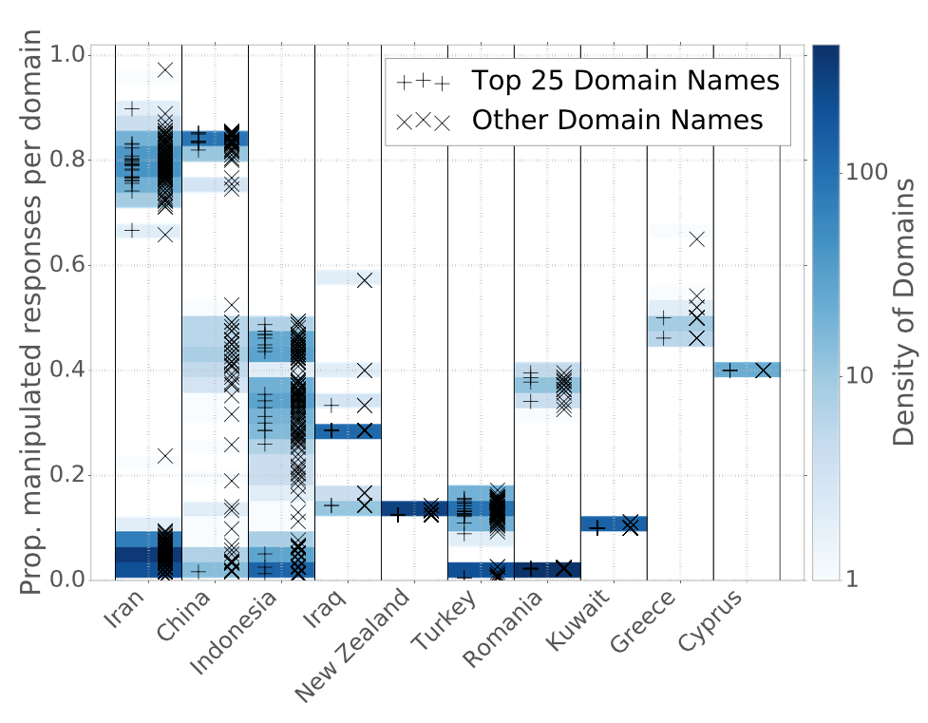
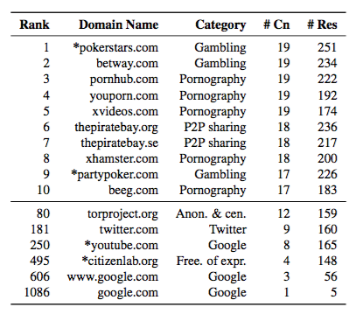
Manipulation of Domains within Countries
Notes:
----- Meeting Notes (4/14/17 13:50) -----
Need a version of this plot by category.

Slide 9
Control of Online Speech
Who gets to speak? Filtering and manipulation of Internet protocols
HTTP, TCP/IP, DNS
Circumvention tools (e.g., Tor)
Who can be heard? Filtering and manipulation on Internet platforms
Filter bubbles, Personalization (and attacks)
Automated filtering
Propaganda and bots

Slide 10
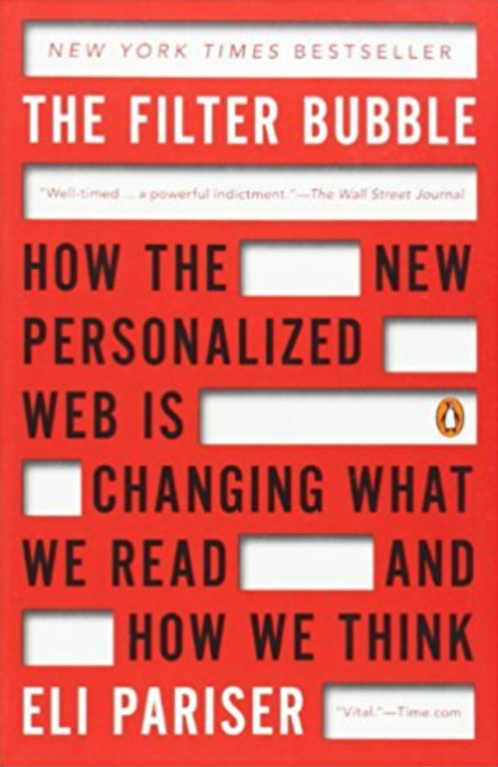
Notes:
May 2011

Slide 11
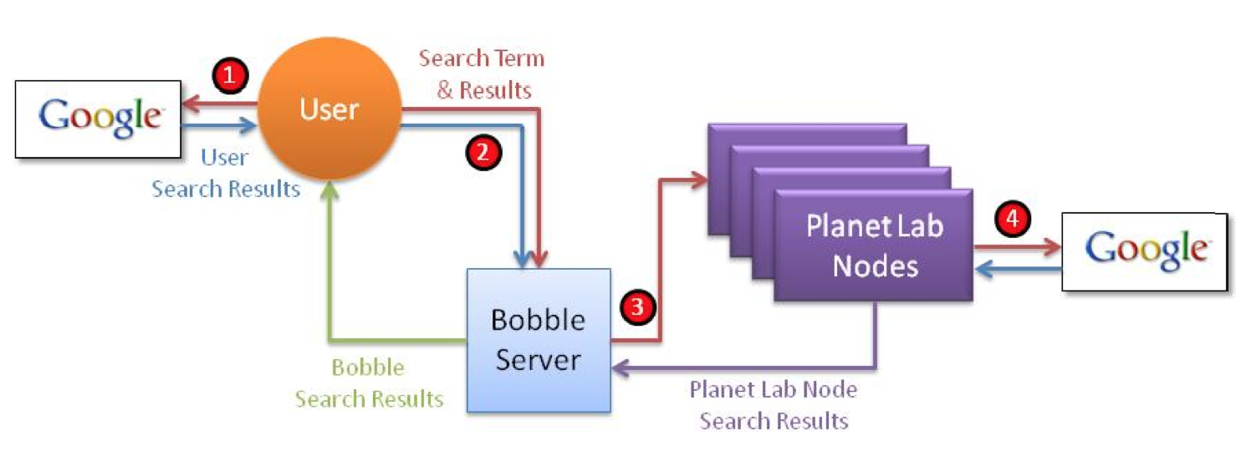
Bobble: Measuring Filter Bubbles
Execute query
As different users
Different vantage points
With different history (e.g., cookies)
Compare differences in results
What shows up on the first page?
Where does it show up?
When it doesn’t appear, what are the possible explanations?

Slide 12
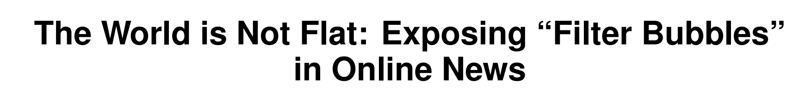
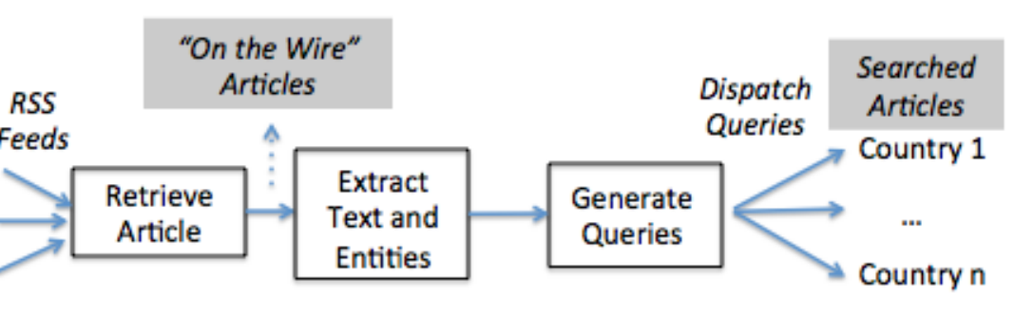
Happens for News, Too…
20% of news sources responsible for 80% of articles
Local sources ranked higher
8,000 queries returned a result in one country but zero results in at least one other country

Slide 13
What about bad inputs?

Slide 14
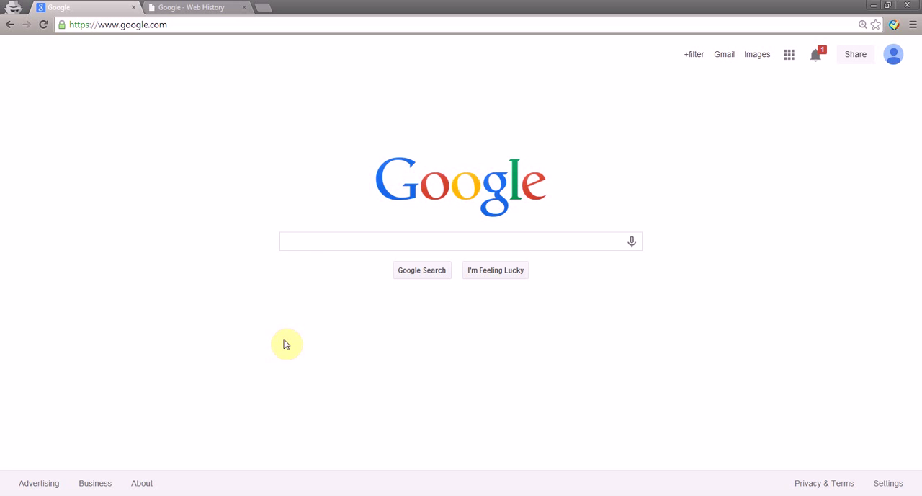
Pollution Attacks
Take This Personally: Pollution Attacks on Personalized Services. X. Xing, W. Ming, D. Doozan, A. Snoeren, N. Feamster, W. Lee. In USENIX Security Symposium, 2013.

Slide 15
Control of Online Speech
Who gets to speak? Filtering and manipulation of Internet protocols
HTTP, TCP/IP, DNS
Circumvention tools (e.g., Tor)
Who can be heard? Filtering and manipulation on Internet platforms
Filter bubbles, Personalization (and attacks)
Automated filtering
Propaganda and bots

Slide 16
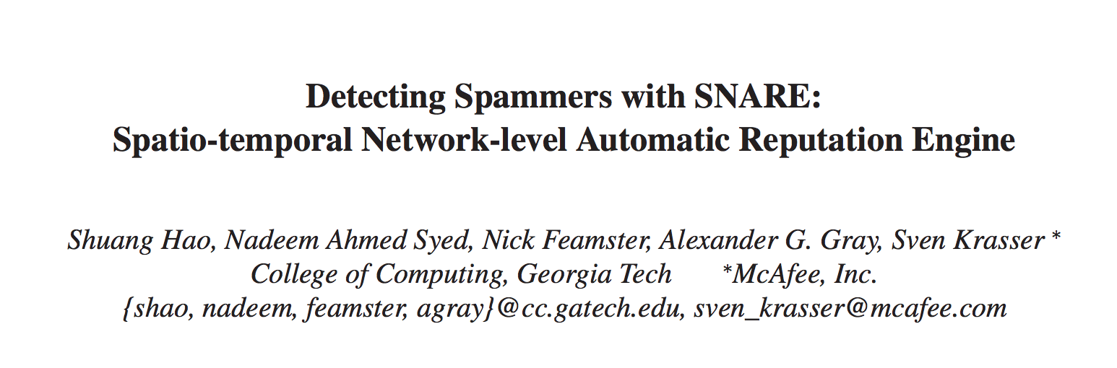
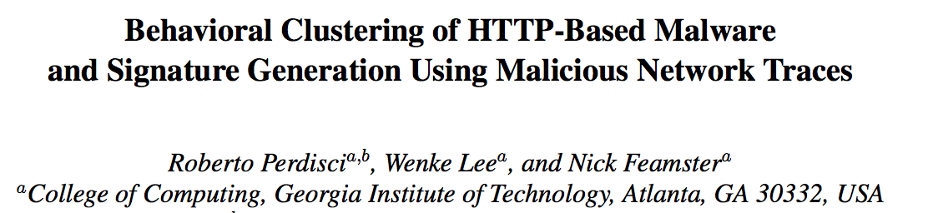
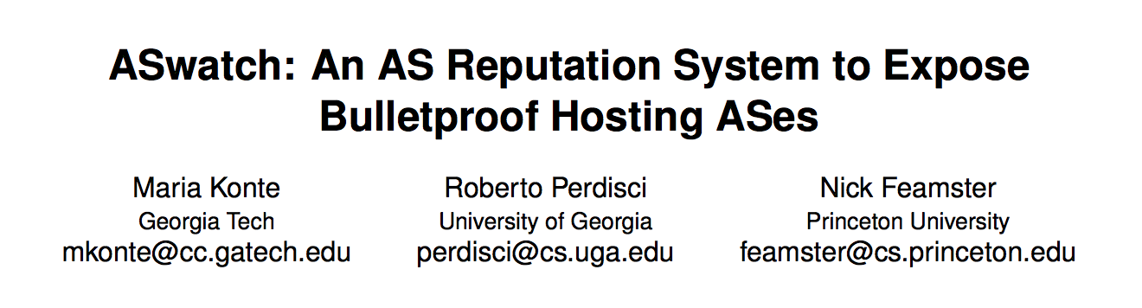
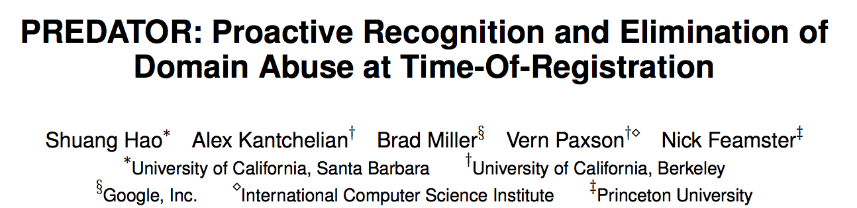
Filtering “Unwanted Content”
Email Spam (2009)
Web-based Malware (2010)
Bulletproof Web Hosting (2015)
Early Detection of DNS Abuse (2016)

Slide 17
Filtering “unwanted content” is nothing but goodness, right…?

Slide 18
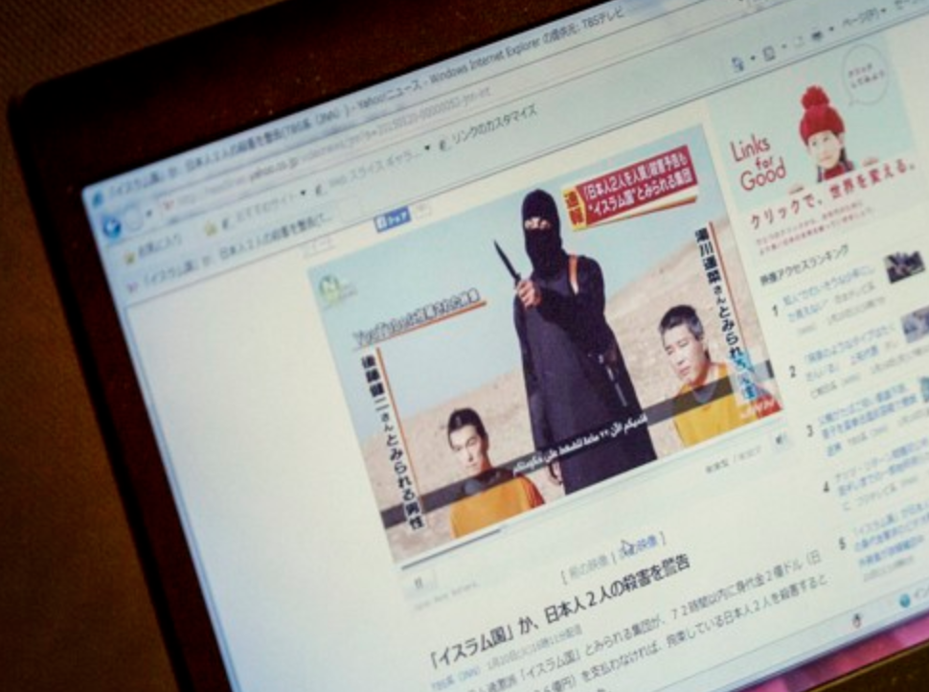
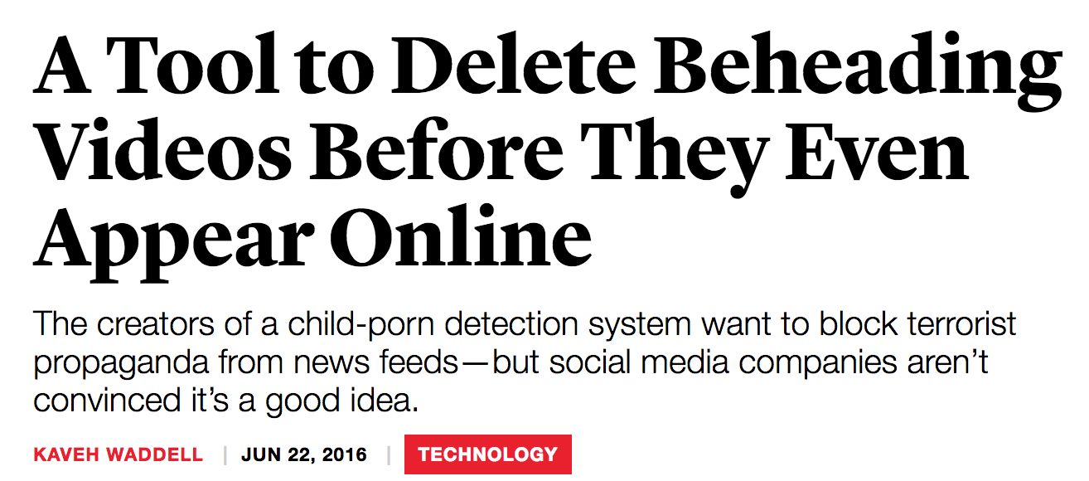
Automated Filtering and Speech
Notes:
“oh wait… you can take down other stuff, too?”

Slide 19
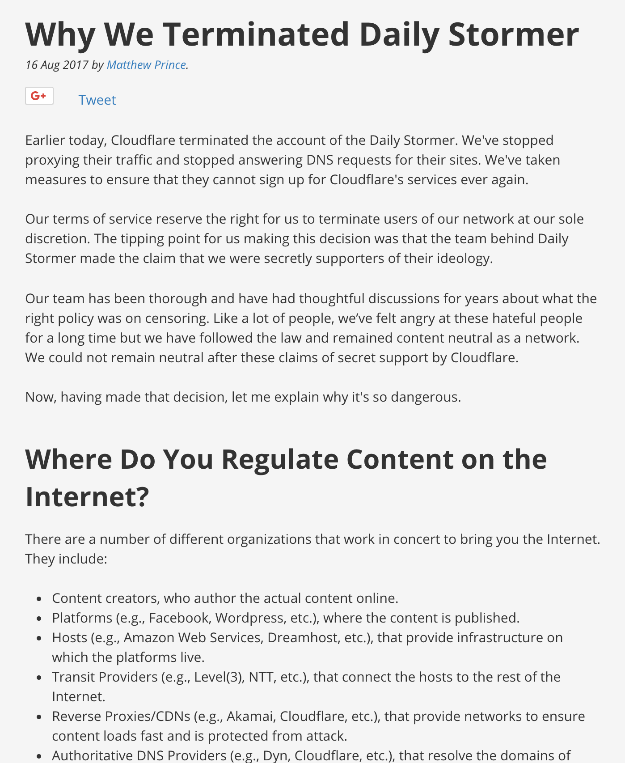

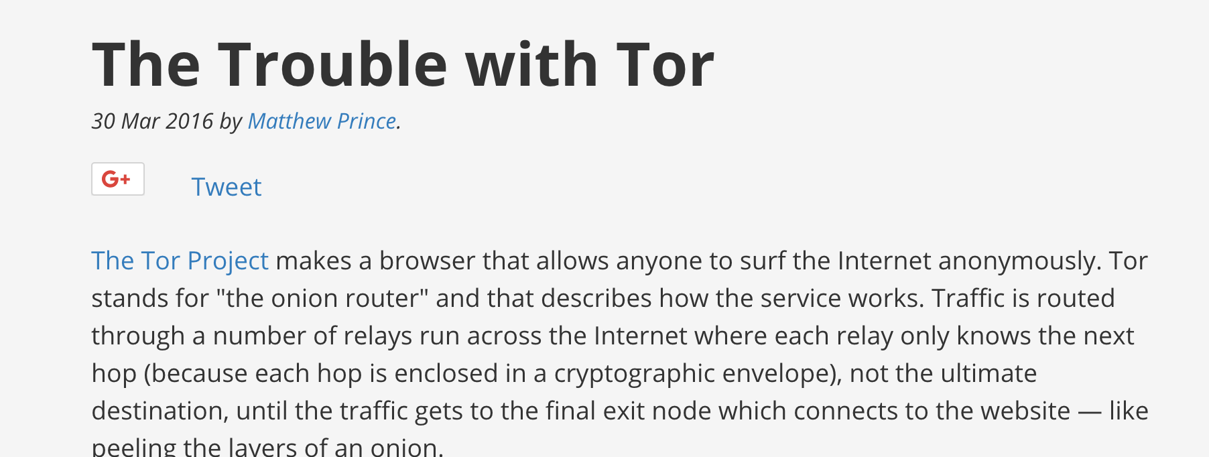
Centralization of Internet content platforms is exacerbating takedown risk.

Slide 20
General content moderation is harder than the “old” problems.
Offending content is infinite
Context is absent
Fair use?
Parody?
…

Slide 21
Control of Online Speech
Who gets to speak? Filtering and manipulation of Internet protocols
HTTP, TCP/IP, DNS
Circumvention tools (e.g., Tor)
Who can be heard? Filtering and manipulation on Internet platforms
Filter bubbles, Personalization (and attacks)
Automated filtering
Propaganda and bots

Slide 22
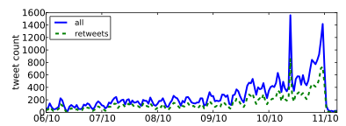
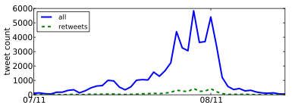
Detecting “Propaganda”
Nevada Senate Race
Higher fraction of retweets
More bursty tweeting volumes
Higher daily volumes
Quick retweeting
Debt Ceiling Debate
#bias: Measuring the Tweeting Behavior of Propagandists
by Cristian Lumezanu, Nick Feamster, and Hans Klein.
In the Sixth International AAAI Conference on Weblogs and Social Media (ICWSM), 2012.
Notes:
Note: This study likely no longer works.

Slide 23
Online Expression: Looking Ahead
Technology: What are capabilities, limitations?
Understanding/mitigating bad inputs to personalization
Understanding/pushing the limits of automated filtering
Observing and auditing the platforms
Policy: What can/should be required?
Of content providers?
Of platforms and intermediaries?

